Slide 1

Faculty of Business and Management
Minor Programme Information

Slide 2
Content
Minor Programme in Accounting
Minor Programme in Applied Economics
Minor Programme in Business
Minor Programme in e-Business Management and Applications
5. Minor Programme in Entrepreneurship and Innovation
6. Minor Programme in Finance
7. Minor Programme in Management of Human Resources
8. Minor Programme in Marketing Management

Slide 3
01
Minor Programme in Accounting
01
01
Programme Aims, Objectives and Intended Learning Outcomes
The Minor Programme in Accounting aims to provide opportunities for students to pursue their interest in accounting and to apply the knowledge in the workplace of their major field of studies.
The Minor Programme in Accounting is structured firstly to provide students with a foundation of knowledge and techniques in accounting to become creative problem solvers, critical thinkers and team leaders in managing and tackling real world accounting problems and issues related to their major fields of study; and secondly to promote lifelong learning.
Target Students
BNBU non-FBM students.

Slide 4
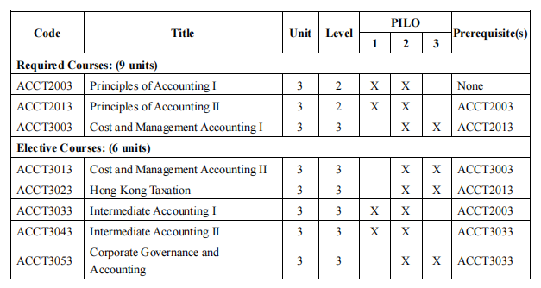
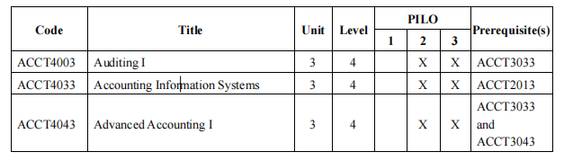
01
Minor Programme in Accounting
01
01
Programme Structure
The Minor Programme in Accounting consists of 3 required courses and 2 electives from the list of elective courses.

Slide 5
02
Minor Programme in Applied Economics
01
Programme Aims, Objectives and Intended Learning Outcomes
The Minor Programme in Applied Economics aims to provide students with a firm foundation of knowledge about the workings of economic systems and to develop their analytical skills for the constructive use of that knowledge in multidisciplinary areas that involve economics.
The programme is designed to stimulate students intellectually through the study of a range of economic problems and an appreciation of the economic impacts on business, social, political and environmental issues.
Target Students
BNBU non-FBM students.

Slide 6
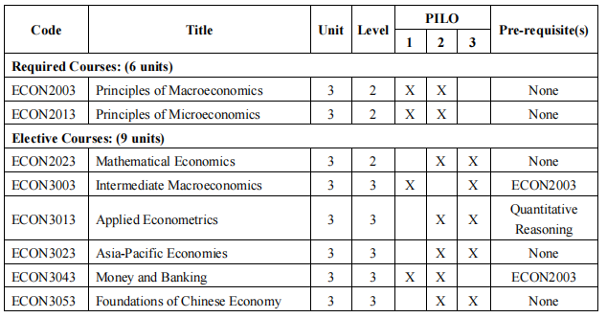
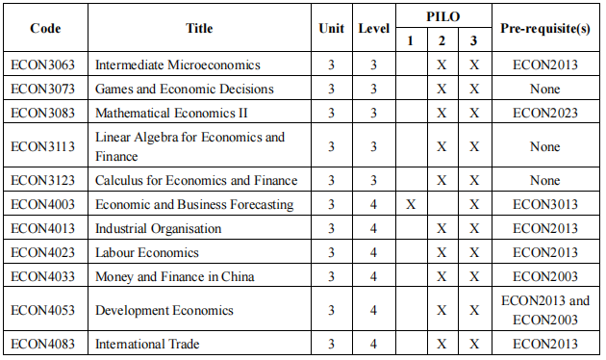
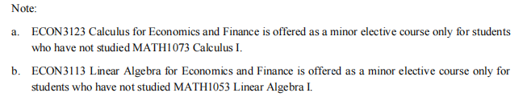
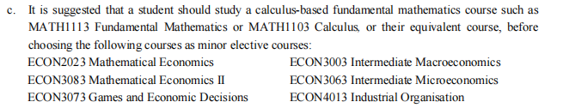
02
Minor Programme in Applied Economics
01
Programme Structure
The Minor Programme in Applied Economics consists of 2 required courses and 3 electives from the list of elective courses as stipulated in the Table.

Slide 7
03
01
Minor Programme in Business
Programme Aims, Objectives and Intended Learning Outcomes
Businesses look for employees who have good communication and interpersonal skills, possess strong analytical skills, think creatively and be able to integrate information from diverse sources. The curriculum of the Minor Programme in Business will provide non-BBA students with a broad introduction of fundamental business concepts through well-developed integrated and cohesive courses needed for success in the rapid evolving business arena. It draws on the core courses to provide exposure to contemporary business concepts and practice. Students will develop a foundation in the various functional areas in business.
Through the Minor Programme in Business, non-BBA students will gain critical insights into business process through the courses studied in accounting, finance, management, and marketing. They will also develop critical and analytical skills, effective communication skills, and a global perspective.
Target Students
BNBU Non-BBA students.

Slide 8
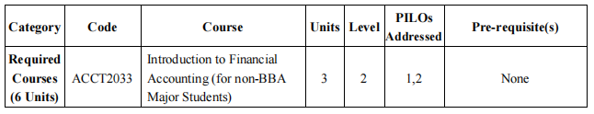
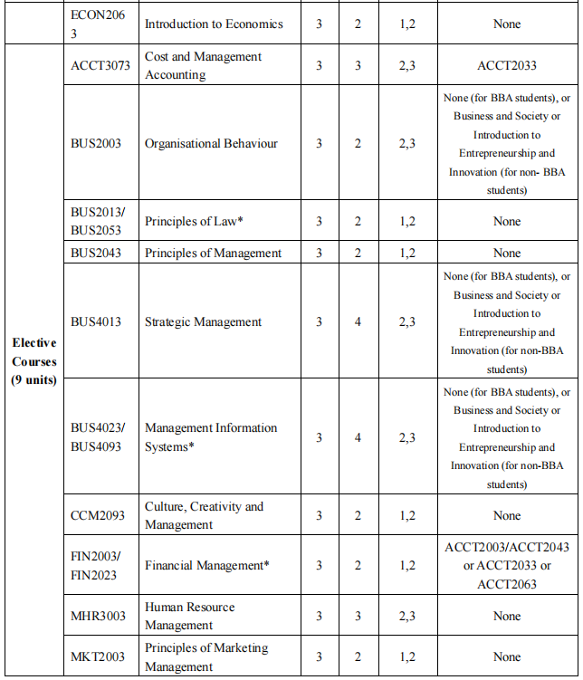
03
03
01
Minor Programme in Business
Programme Structure
Students of the Minor Programme in Business are required to complete 2 required courses and 3 elective courses as stipulated in the Table, in which at least one course should be at level 3 or above.

Slide 9
04
Minor Programme in e-Business Management and Applications
01
Programme Aims, Objectives and Intended Learning Outcomes
The Minor Programme in e-Business Management and Applications aims to equip students with fundamental knowledge and techniques in managing e-businesses and in integrating e-business with other business models, in order to become creative problem solvers, critical thinkers and team leaders in managing and tackling real world problems.
The Minor Programme in e-Business Management and Applications is structured to provide students with opportunities to pursue their interest in e-business management and applications within a structured curriculum, promoting understanding across disciplines and broadening the context for life-long learning. It also helps to develop in students a range of intellectual and practical skills readily transferrable to work settings in their chosen career fields.
Target Students
BNBU students except for students in the EBIS major programme.

Slide 10
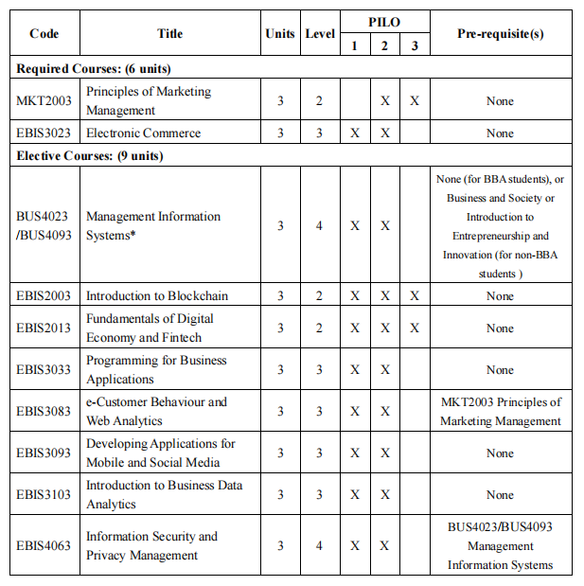
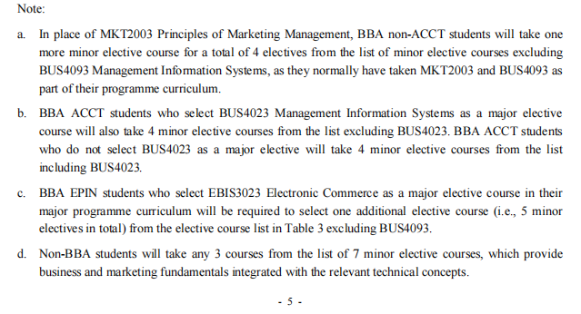
04
Minor Programme in e-Business Management and Applications
04
01
Programme Structure
The Minor Programme in e-Business Management and Applications consists of 2 required courses and 3 elective courses.

Slide 11
05
Minor Programme in Entrepreneurship and Innovation
01
Programme Aims, Objectives and Intended Learning Outcomes
The Minor Programme in EPIN aims to significantly enhance the educational experience of students while better preparing them to deal with the world around them. The focus here is on developing students’ entrepreneurial mindset and their ability to cultivate critical skills to think and act in more creative, innovative, opportunistic and proactive ways.
To achieve these aims, the design and structure of the Minor Programme in EPIN include required and elective courses with solid experiential content, and provide opportunities for entrepreneurs to share their valuable experiences with students through workshops, entrepreneurial seminars and field trips to start-ups and large business enterprises.
In sum, the aims and objectives of the Minor Programme in Entrepreneurship and Innovation are:
(1) to apply diverse concepts of business and society and to develop creative capacities that are essential to initiate, build, and grow business ventures;
(2) to nurture entrepreneurial spirit and competencies by applying business-related knowledge and skills to develop and implement innovative ideas required for sustaining and growing organizational and new business undertakings.

Slide 12
05
Minor Programme in Entrepreneurship and Innovation
05
01
Target Students
The target students of the Programme are BNBU non-FBM students.
Programme Structure
The Minor Programme in Entrepreneurship and Innovation consists of 1 required course followed by 4 electives from the list of elective courses as stipulated in the Table. Students are required to complete at least one course at level 3 or above.
Students have to take EPIN3003. For non-BBA students, they have to take 12 units from Elective Courses I and Elective Courses II. Students who have taken any of the above courses in their major programmes have to take additional elective course(s) to fulfil the minor programme requirement.

Slide 13
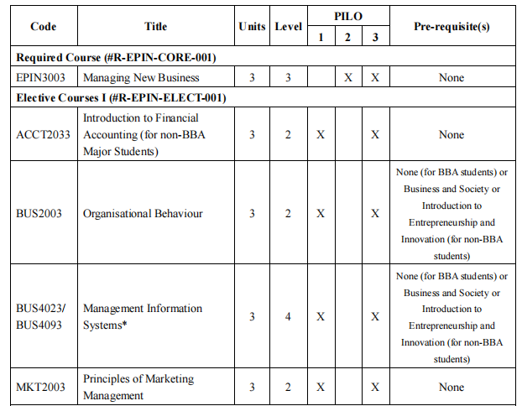
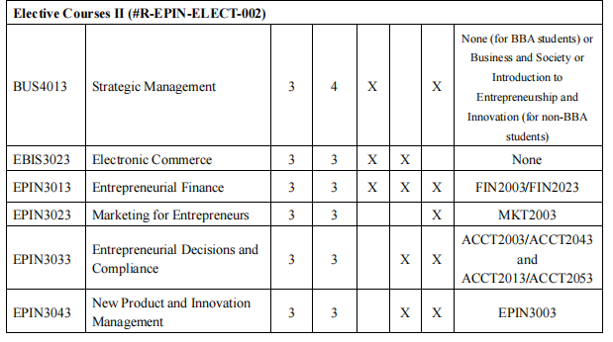
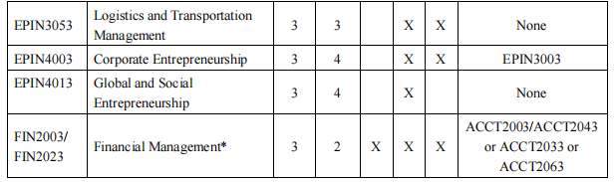
05
Minor Programme in Entrepreneurship and Innovation
05
01
Table: Curriculum Structure of the Minor Programme in EPIN

Slide 14
06
01
Minor Programme in Finance
Programme Aims, Objectives and Intended Learning Outcomes
The Minor Programme in Finance aims to provide opportunities for students to pursue their interest in finance and to apply the knowledge in the work place of their major field of studies. The Minor Programme in Finance is structured to provide students with a foundation of knowledge and techniques in financial management in order to become creative problem solvers, critical thinkers and team leaders in managing and tackling real world finance problem and issues related to their major fields of study.
Target Students
BNBU students including BNBU non-FIN students.

Slide 15
06
06
01
Minor Programme in Finance
Programme Structure
The Minor Programme in Finance consists of 1 required course and 4 electives from Elective Courses. Students are required to complete 4 elective courses as stipulated in the Table, in which at least one course should be at level 3 or above.
For non-BBA students, they should take ACCT2003/ACCT2043 Principles of Accounting I and FIN2003/FIN2023 Financial Management as pre-requisite requirement of the required course and other elective courses.
For BBA but non-FIN students, since they would study ACCT2003/ACCT2043 Principles of Accounting I and FIN2003/FIN2023 Financial Management as their BBA core courses, they should choose two other electives instead. The curriculum is summarised in the Table shown below.

Slide 16
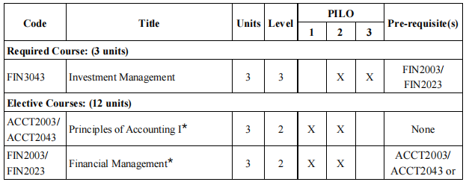
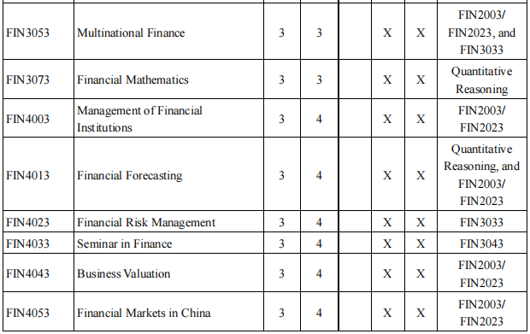
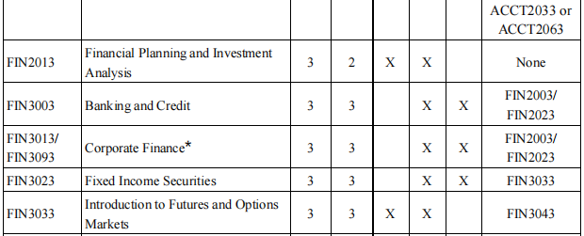
06
01
Minor Programme in Finance
Table: Curriculum Structure of the Minor Programme in Finance

Slide 17
07
01
Minor Programme in Management of Human Resources
Programme Aims, Objectives and Intended Learning Outcomes
The Minor Programme in Management of Human Resources aims to provide students with comprehensive understanding of the field of Management of Human Resource to complement the knowledge of their major field of studies. The field of Management of Resource Management is ubiquitous such that in all industries, managers have to work with human resource issues. The structure of this Minor Programme provides students with a foundation of knowledge and techniques in Management of Human Resource, allowing the students to develop the skills required to become competent managers. Upon completion of this minor programme, the students will be equipped with the analytical and problem solving skills to handle human resource-related issues in their respective specialty fields.
Target Students
BNBU non-FBM students.

Slide 18
07
01
Minor Programme in Management of Human Resources
Programme Structure
The Minor Programme in Management of Human Resources consists of 1 required course and 4 electives, 2 from Group A and 2 from Group B Elective Courses. The compulsory course MHR3003 Human Resource Management is the foundation course for all other MHR courses; and, the seekers of the Minor Programme should take this as the first course in the Minor Programme.
Group A elective courses are the major required courses that cover the basic human resources management functions. The seekers can select two out of the four courses.
Group B elective courses will introduce students to the other specialty knowledge in the field of MHR. The seekers can select any two of the courses in Group B.

Slide 19
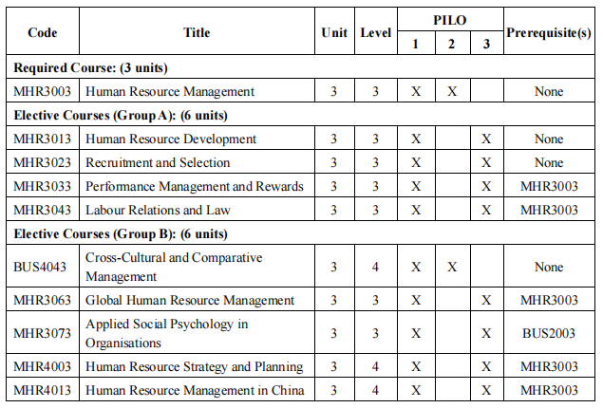
07
07
01
Minor Programme in Management of Human Resources
Table: Curriculum Structure of the Minor Programme in MHR

Slide 20
08
Minor Programme in Marketing Management
01
Programme Aims, Objectives and Intended Learning Outcomes
The aims and objectives of the Minor Programme in Marketing Management are:
(1) Enable students to build a solid knowledge foundation in the basic structure of business and how marketing fits into this structure as a strategic business partner;
(2) Educate students about the unique characteristics and underlying principles of the marketing functional areas of a business, with a special emphasis on issues, challenges and opportunities facing marketing, and the strategic impact marketers can contribute towards profitability in enterprises;
(3) Impart knowledge in both the theoretical and practical functions of marketing management and marketing applications for organisational strategic development;
Target Students
BNBU non-FBM students.

Slide 21
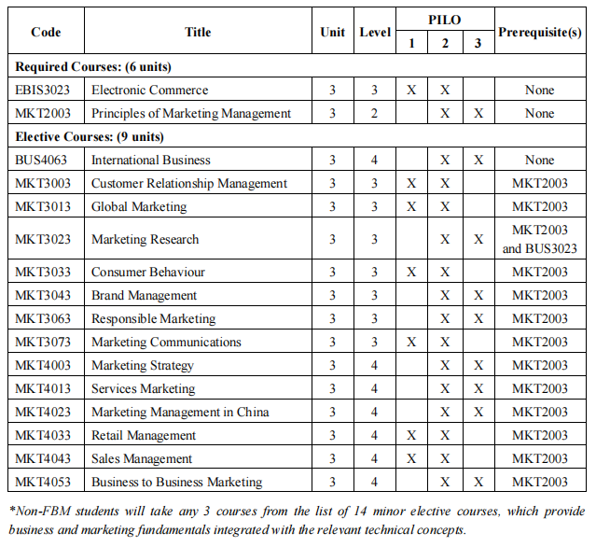
08
08
Minor Programme in Marketing Management
01
Programme Structure
The Minor Programme in Marketing Management consists of 2 required courses and 3 elective courses. Students are required to complete three elective courses as stipulated in the Table.

Slide 22

Contact person: Ms. Georgina Zhong
Tel: 0756-3677719
E-mail: georginazjzhong@bnbu.edu.cn
THANK YOU

